Slide 1
CSS COLOR and LAYOUT PROPERTIES

Slide 2
Objectives
CSS Backgrounds
CSS Borders
CSS Syntax and Selectors
CSS Margins
CSS Padding
CSS Height and Width Dimensions
CSS Text
CSS Fonts
CSS Links
CSS Lists
CSS Tables

Slide 3
CSS Color and Layout Properties
CSS Backgrounds
The CSS background properties are used to define the background effects for elements.
CSS background properties:
background-color
background-image
background-repeat
background-attachment
background-position

Slide 4
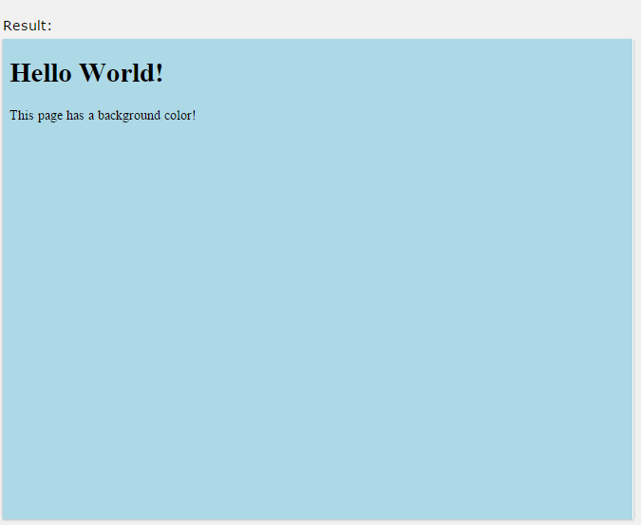
Background Color
The background-color property specifies the background color of an element.
The background color of a page is set like this:
body {
background-color: lightblue;
}

Slide 5
Background Color
With CSS, a color is most often specified by:
a HEX value - like "#ff0000"
an RGB value - like "rgb(255,0,0)"
a valid color name - like "red"
Look at CSS Color Values for a complete list of possible color values.
In the example below, the <h1>, <p>, and <div> elements have different background colors:

Slide 6
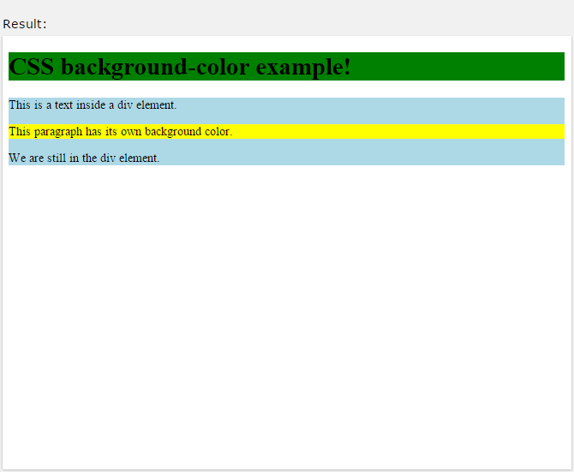
Background Color
Example
h1 {
background-color: green;
}
div {
background-color: lightblue;
}
p {
background-color: yellow;
}

Slide 7
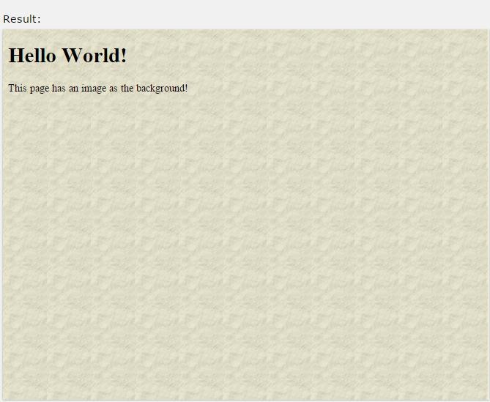
Background Image
The background-image property specifies an image to use as the background of an element.
By default, the image is repeated so it covers the entire element. The background image for a page can be set like this:
Example
body {
background-image: url("paper.gif");
}

Slide 8
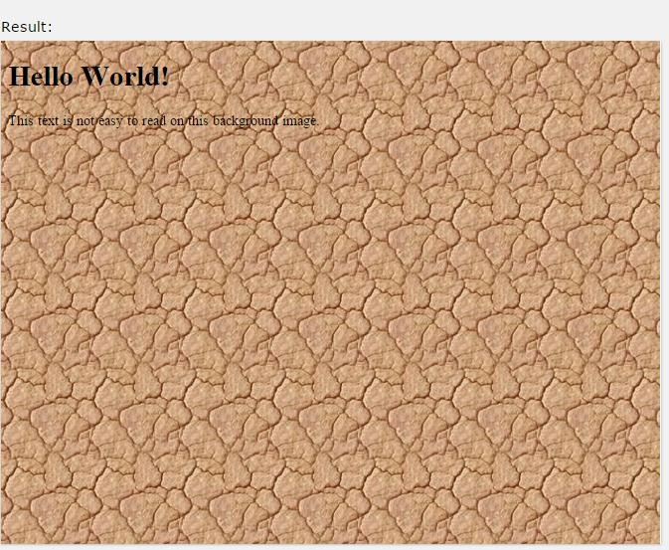
2.1.2 Background Image
Below is an example of a bad combination of text and background image. The text is hardly readable:
Example
body {
background-image: url("bgdesert.jpg");
}

Slide 9
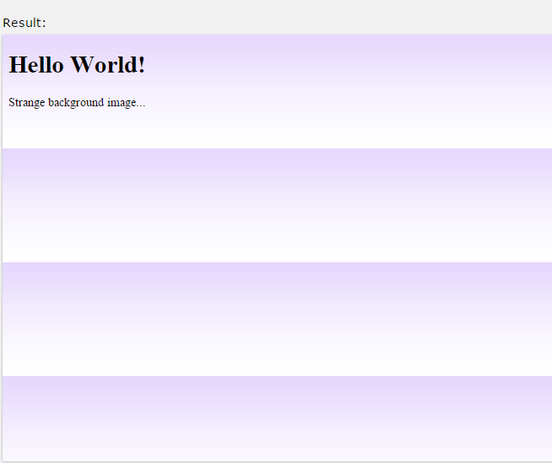
2.1.2.1 Background Image - Repeat Horizontally or Vertically
By default, the background-image property repeats an image both horizontally and vertically.
Some images should be repeated only horizontally or vertically, or they will look strange, like this:
Example
body {
background-image: url("gradient_bg.png");
}

Slide 10
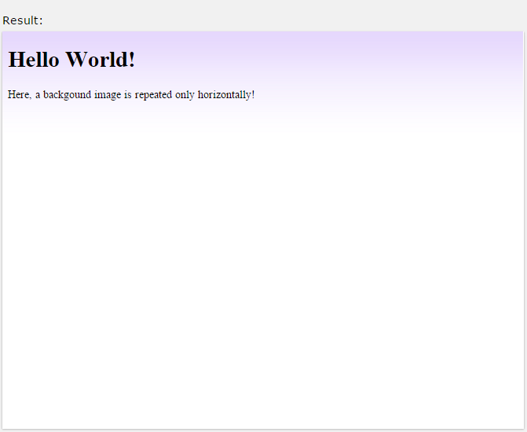
If the image above is repeated only horizontally (background- repeat: repeat-x;), the background will look better:
Example
body {
background-image: url("gradient_bg.png"); background-repeat: repeat-x;
}

Slide 11
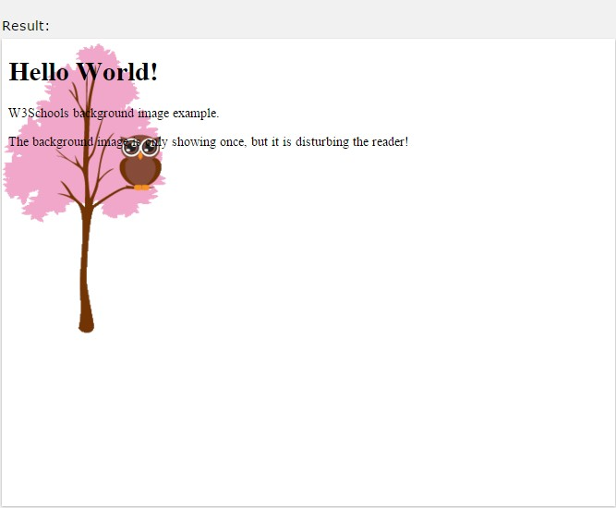
2.1.2.2 Background Image - Set position and no-repeat
Showing the backgound image only once is also specified by the background-repeat property:
Example
body {
background-image: url("img_tree.png"); background-repeat: no-repeat;
}

Slide 12
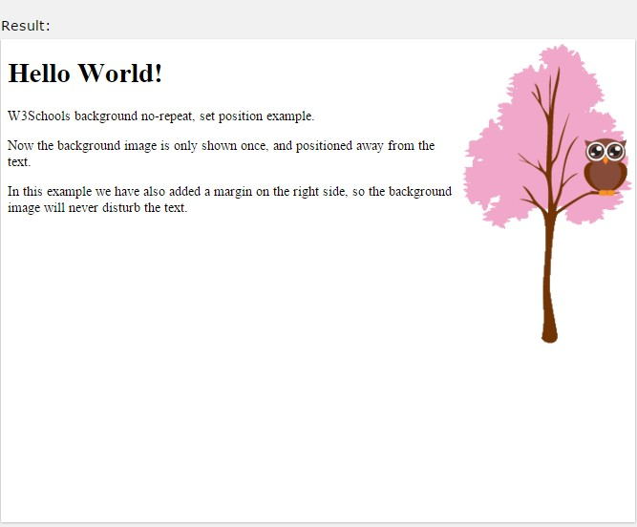
2.1.2.2 Background Image - Set position and no-repeat
In the example above, the background image is shown in the same place as the text. We want to change the position of the image, so that it does not disturb the text too much.
The position of the image is specified by the position property:
background-
body {
background-image: url("img_tree.png"); background-repeat: no-repeat; background-position: right top;
}

Slide 13
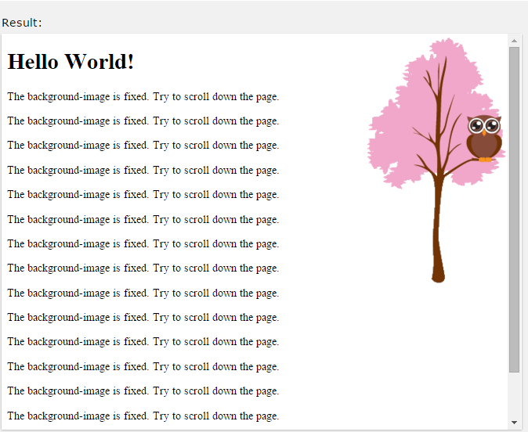
2.1.2.3 Background Image - Fixed position
To specify that the background image should be fixed (will not
scroll with the rest of the page), use the
background-
attachmentproperty:
Example
body {
background-image: url("img_tree.png"); background-repeat: no-repeat; background-position: right top; background-attachment: fixed;
}

Slide 14
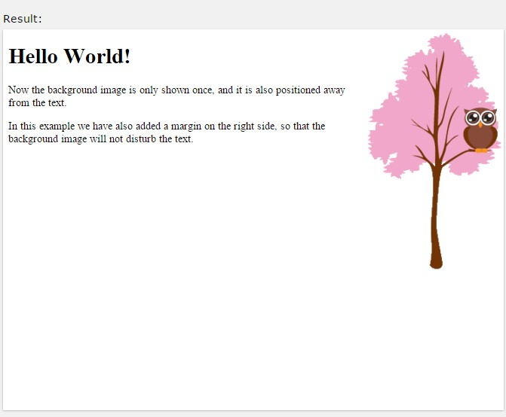
2.1.3
Background - Shorthand property
To shorten the code, it is also possible to specify all the background properties in one single property. This is called a shorthand property.
The shorthand property for background is background: Example
body {
background: #ffffffurl("img_tree.png") no-repeat right top;
}

Slide 15
2.1.3 Background - Shorthand property
When using the shorthand property the order of the property values is:
background-color
background-image
background-repeat
background-attachment
background-position
It does not matter if one of the property values is missing, as long as the other ones are in this order.

Slide 16
All CSS Background Properties
Property | Description
background | Sets all the background properties in one declaration
background- attachment | Sets whether a background image is fixed or scrolls with the rest of the page
background- color | Sets the background color of an element
background- image | Sets the background image for an element
background- position | Sets the starting position of a background image
background- repeat | Sets how a background image will be repeated

Slide 17
2.2 CSS Borders
2.2.1 CSS Border Properties
The CSS border properties allow you to specify the style, width, and color of an element's border.
This element has a groove border that is 15px wide and green.
2.2.2 Border Style
The border-style property specifies what kind of border to display. The following values are allowed:
dotted
dashed
solid | -
- Defines a dotted border
•
•
- Defines a dashed border Defines a solid border
•

Slide 18
Defines a double border
Defines a 3D grooved border. The effect depends on
2.2.2 Border Style
double groove
•
•
the border-color value
ridge
- Defines a 3D ridged border. The effect depends on the
•
border-color value
inset
- Defines a 3D inset border. The effect depends on the
•
border-color value
outset
- Defines a 3D outset border. The effect depends on the
•
border-color value
none - Defines no border
hidden - Defines a hidden border
The border-style property can have from one to four values (for the top border, right border, bottom border, and the left border).

Slide 19
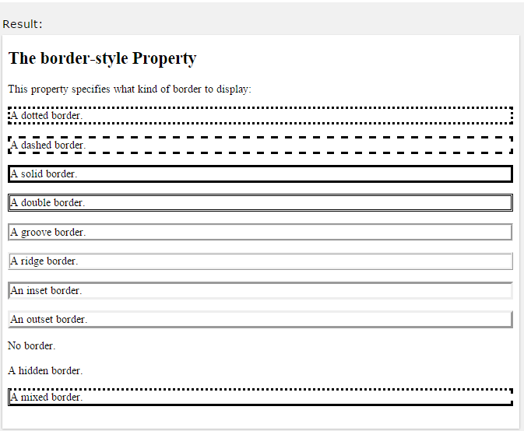
2.2.2 Border Style
Example
p.dotted {border-style: dotted;} p.dashed {border-style: dashed;} p.solid {border-style: solid;} p.double {border-style: double;} p.groove {border-style: groove;} p.ridge {border-style: ridge;} p.inset {border-style: inset;} p.outset {border-style: outset;} p.none {border-style: none;} p.hidden {border-style: hidden;}
p.mix {border-style: dotted dashed solid double;}
Note: None of the OTHER CSS border properties described below will have ANY effect unless the border-style property is set!

Slide 20
2.2.3
Border Width
The border-width property specifies the width of the four borders.
The width can be set as a specific size (in px, pt, cm, em, etc) or by using one of the three pre-defined values: thin, medium, or thick.
The border-width property can have from one to four values (for the top border, right border, bottom border, and the left border).

Slide 21
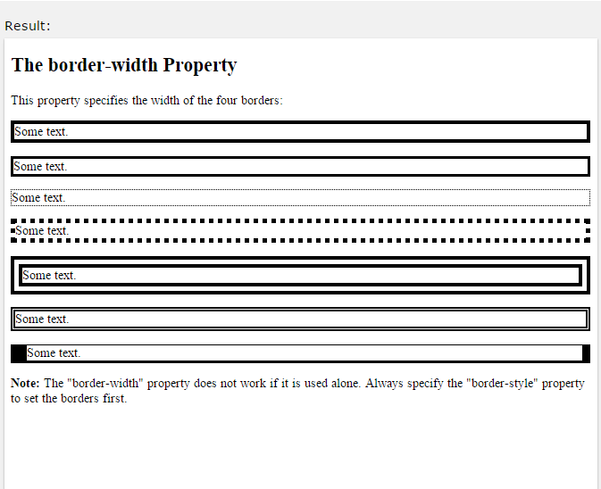
2.2.3 Border Width
Example
p.one {
border-style: solid; border-width: 5px;
}
p.two {
border-style: solid; border-width: medium;
}
p.three {
border-style: solid;
border-width: 2px 10px 4px 20px;
}

Slide 22
2.2.4
Border Color
The border-color property is used to set the color of the four borders.
The color can be set by:
name - specify a color name, like "red"
RGB - specify a RGB value, like "rgb(255,0,0)"
Hex - specify a hex value, like "#ff0000"
transparent
The border-color property can have from one to four values (for
the top border, right border, bottom border, and the left border). If border-color is not set, it inherits the color of the element.

Slide 23
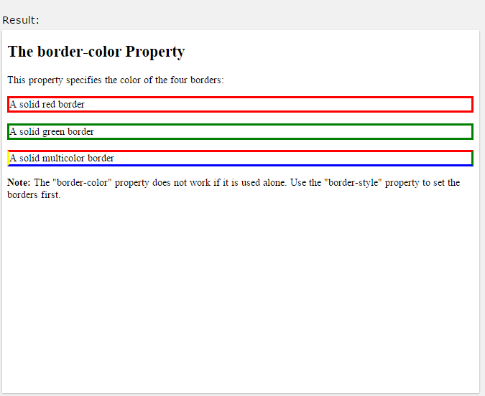
2.2.4 Border Color
Example
p.one {
border-style: solid; border-color: red;
}
p.two {
border-style: solid; border-color: green;
}
p.three {
border-style: solid;
border-color: red green blue yellow;
}

Slide 24
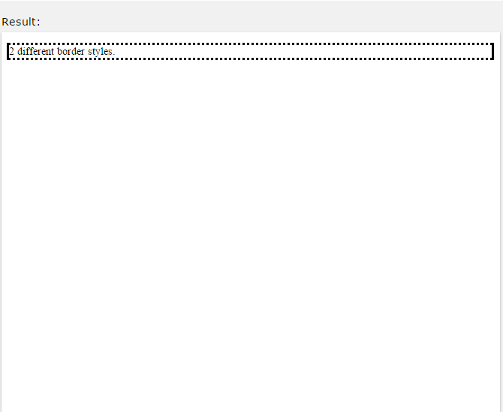
2.2.5 Border - Individual Sides
From the examples above you have seen that it is possible to specify a different border for each side.
In CSS, there is also properties for specifying each of the borders (top, right, bottom, and left):
Example
p {
border-top-style: dotted; border-right-style: solid; border-bottom-style: dotted; border-left-style: solid;
}

Slide 25

2.2.5 Border - Individual Sides
The example above gives the same result as this:
Example
p {
border-style: dotted solid;
}

Slide 26
2.2.5 Border - Individual Sides
So, here is how it works:
If the border-style property has four values:
border-style: dotted solid double dashed;
top border is dotted
right border is solid
bottom border is double
left border is dashed
If the border-style property has three values:
border-style: dotted solid double;
top border is dotted
right and left borders are solid
bottom border is double
If the
border-style
property has two values:

Slide 27
2.2.5 Border - Individual Sides
border-style: dotted solid;
top and bottom borders are dotted
right and left borders are solid
If the border-style property has one value:
border-style: dotted;
all four borders are dotted
The border-style
property is used in the example above. However,
it also works with border-width
and border-color.

Slide 28
2.2.6
Border - Shorthand Property
As you can see from the examples above, there are many properties to consider when dealing with borders.
To shorten the code, it is also possible to specify all the individual border properties in one property.
The border property is a shorthand property for the following individual border properties:
border-width
border-style (required)
border-color

Slide 29
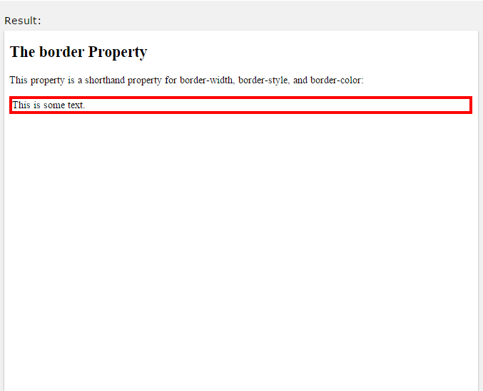
2.2.6 Border - Shorthand Property
Example
p {
border: 5px solid red;
}

Slide 30
2.3 CSS Margins
2.3.1 CSS Margin Properties
The CSS margin properties are used to generate space around elements.
The margin properties set the size of the white space OUTSIDE the border.
This element has a margin of 80px.
2.3.2 CSS Margins
The CSS margin properties OUTSIDE the border.
set the size
of the white
space

Slide 31

2.3.2 CSS Margins
Note: The margins are completely transparent - and cannot have a background color!
With CSS, you have full control over the margins. There are CSS properties for setting the margin for each side of an element (top, right, bottom, and left).

Slide 32
2.3.2.1 Margin - Individual Sides
CSS has properties for specifying the margin for each side of an element:
margin-top
margin-right
margin-bottom
margin-left
All the margin properties can have the following values:
auto - the browser calculates the margin
length - specifies a margin in px, pt, cm, etc.
% - specifies a margin in % of the width of the containing element

Slide 33
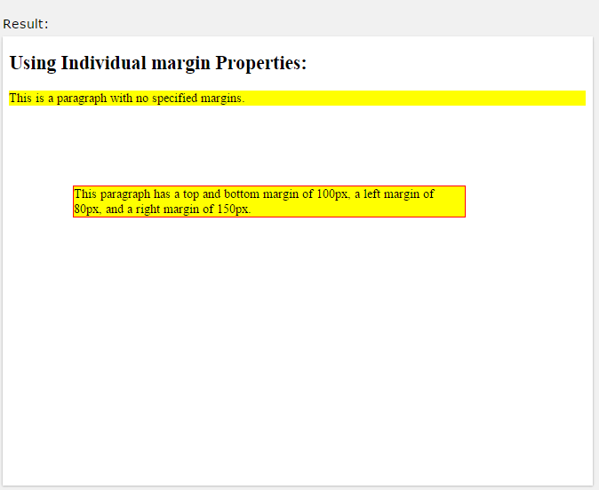
2.3.2.1 Margin - Individual Sides
inherit - specifies that the margin should be inherited from the parent element
Note: It is also possible to use negative values for margins; to overlap content.
p {
margin-top: 100px; margin-bottom: 100px; margin-right: 150px; margin-left: 80px;
}

Slide 34
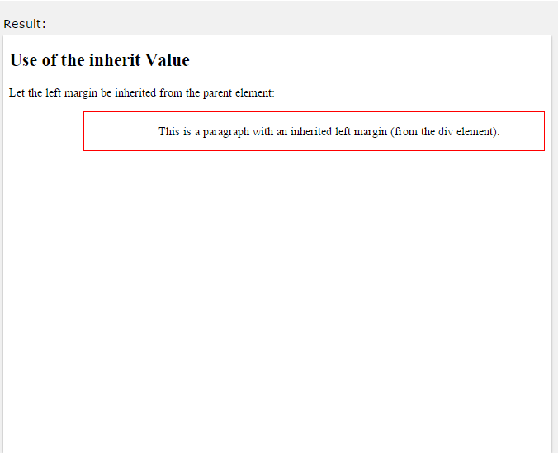
2.3.2.1 Margin - Individual Sides
The following example lets the left margin be inherited from the parent element:
Example
div.container {
border: 1px solid red; margin-left: 100px;
}
p.one {
margin-left: inherit;
}

Slide 35
2.3.2.2 Margin - Shorthand Property
To shorten the code, it is possible to specify all the margin properties in one property.
The margin property is a shorthand property for the following individual margin properties:
margin-top
margin-right
margin-bottom
margin-left

Slide 36
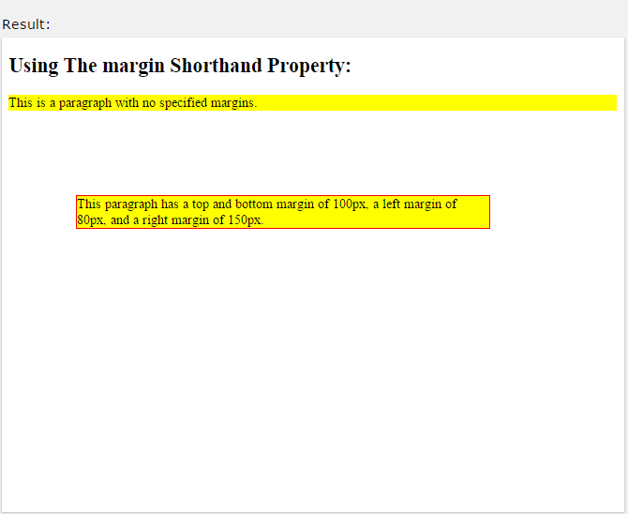
2.3.2.2 Margin - Shorthand Property
Example
p {
margin: 100px 150px 100px 80px;
}

Slide 37
2.3.2.2 Margin - Shorthand Property
So, here is how it works:
If the margin property has four values:
margin: 25px 50px 75px 100px;
top margin is 25px
right margin is 50px
bottom margin is 75px
left margin is 100px
If the margin property has three values:
margin: 25px 50px 75px;
top margin is 25px
right and left margins are 50px
bottom margin is 75px
If the
margin
property has two values:

Slide 38
2.3.2.2 Margin - Shorthand Property
margin: 25px 50px;
top and bottom margins are 25px
right and left margins are 50px
If the margin property has one value:
margin: 25px;
all four margins are 25px

Slide 39
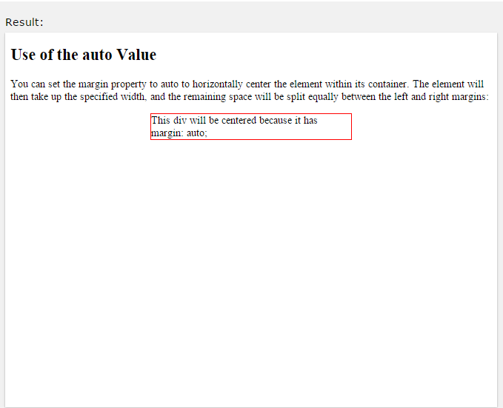
2.3.3 Use of The auto Value
You can set the margin property to element within its container.
auto
to horizontally center the
The element will then take up the specified width, and the remaining space will be split equally between the left and right margins:
Example
div {
width: 300px; margin: auto;
border: 1px solid red;
}

Slide 40
All CSS Margin Properties
2.3.4
Property | Description
margin | A shorthand property for setting the margin properties in one declaration
margin-bottom | Sets the bottom margin of an element
margin-left | Sets the left margin of an element
margin-right | Sets the right margin of an element
margin-top | Sets the top margin of an element

Slide 41
2.4 CSS Padding
2.4.1 CSS Padding Properties
The CSS padding properties are used to generate space around content.
The padding properties set the size of the white space between the element content and the element border.
This element has a padding of 50px.

Slide 42
2.4.2 CSS Padding
The CSS padding properties define the white space between the element content and the element border.
The padding clears an area around the content (inside the border) of an element.
Note: The padding is affected by the background color of the element!
With CSS, you have full control over the padding. There are CSS properties for setting the padding for each side of an element (top, right, bottom, and left).

Slide 43
2.4.2.1 Padding - Individual Sides
CSS has properties for specifying the padding for each side of an element:
padding-top
padding-right
padding-bottom
padding-left
All the padding properties can have the following values:
length - specifies a padding in px, pt, cm, etc.
% - specifies a padding in % of the width of the containing element
inherit - specifies that the padding should be inherited from the parent element

Slide 44
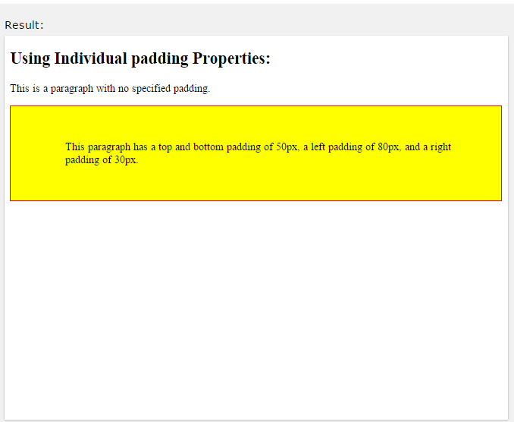
2.4.2.1 Padding - Individual Sides
The following example sets different padding for all four sides of a
<p> element:
Example
p {
padding-top: 50px; padding-right: 30px; padding-bottom: 50px; padding-left: 80px;
}

Slide 45
2.4.2.2 Padding - Shorthand Property
To shorten the code, it is possible to specify all the padding properties in one property.
The padding property is a shorthand property for the following individual padding properties:
padding-top
padding-right
padding-bottom
padding-left

Slide 46
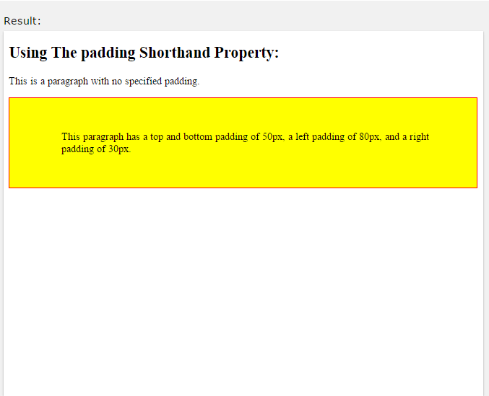
2.4.2.2 Padding - Shorthand Property
Example
p {
padding: 50px 30px 50px 80px;
}

Slide 47
2.4.2.2 Padding - Shorthand Property
So, here is how it works:
If the padding property has four values:
padding: 25px 50px 75px 100px;
top padding is 25px
right padding is 50px
bottom padding is 75px
left padding is 100px
If the padding property has three values:
padding: 25px 50px 75px;
top padding is 25px
right and left paddings are 50px
bottom padding is 75px
If the
padding
property has two values:

Slide 48
2.4.2.2 Padding - Shorthand Property
padding: 25px 50px;
top and bottom paddings are 25px
right and left paddings are 50px
If the padding property has one value:
padding: 25px;
all four paddings are 25px

Slide 49
All CSS Padding Properties
2.4.3
Property | Description
padding | A shorthand property for setting all the padding properties in one declaration
padding- bottom | Sets the bottom padding of an element
padding-left | Sets the left padding of an element
padding-right | Sets the right padding of an element
padding-top | Sets the top padding of an element

Slide 50
2.5 CSS Height and Width Dimensions
2.5.1 CSS Dimension Properties
The CSS dimension properties allow you to control the height and width of an element.
This element has a width of 100%.
2.5.2 Setting height and width
The height and width properties are used to set the height and width of an element.
The height and width
can be set to auto (this is default. Means that
the browser calculates the height and width), or be specified inlength values, like px, cm, etc., or in percent (%) of the containing block.

Slide 51
2.5.2 Setting height and width
This <div> element has a height of 100 pixels and a width of 500 pixels.
Note: The height and width properties do not include padding, borders, or margins; they set the height/width of the area inside the padding, border, and margin of the element!
The following example shows a <div> element with a height of 100 pixels and a width of 500 pixels:

Slide 52
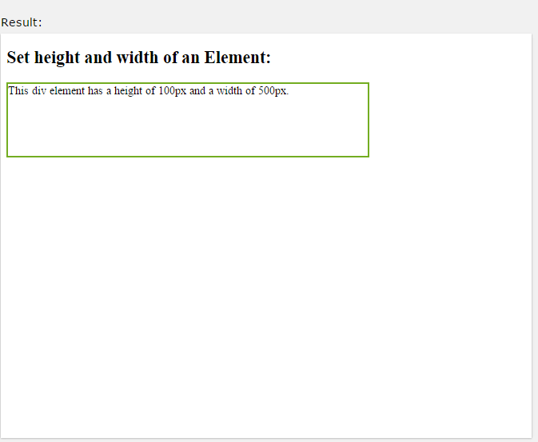
2.5.2 Setting height and width
Example
div {
width: 500px; height: 100px;
border: 3px solid #73AD21;
}

Slide 53
2.5.3
Setting max-width
The
max-width
property is used to set the maximum width of an
element.
The max-width can be specified in length values, like px, cm, etc., or in percent (%) of the containing block, or set to none (this is default. Means that there is no maximum width).
The problem with the <div> above occurs when the browser window is smaller than the width of the element (500px). The browser then adds a horizontal scrollbar to the page.
Using max-width instead, in this situation, will improve the browser's handling of small windows.

Slide 54
2.5.3 Setting max-width
Tip: Drag the browser window to smaller than 500px wide, to see the difference between the two divs!
This <div> element has a height of 100 pixels and a max-width of 500 pixels.
Note: The value of the max-width property overrides width.
The following example shows a <div> element with a height of 100 pixels and a max-width of 500 pixels:

Slide 55
2.5.3 Setting max-width
Example
div {
max-width: 500px; height: 100px;
border: 3px solid #73AD21;
}

Slide 56
All CSS Dimension Properties
2.5.4
Property | Description
height | Sets the height of an element
max-height | Sets the maximum height of an element
max-width | Sets the maximum width of an element
min-height | Sets the minimum height of an element
min-width | Sets the minimum width of an element
width | Sets the width of an element

Slide 57
2.6 CSS Text
2.6.1
Text Color
The color property is used to set the color of the text. With CSS, a color is most often specified by:
a HEX value - like "#ff0000"
an RGB value - like "rgb(255,0,0)"
a color name - like "red"
Look at CSS Color Values for a complete list of possible color values.
The default text color for a page is defined in the body selector.

Slide 58
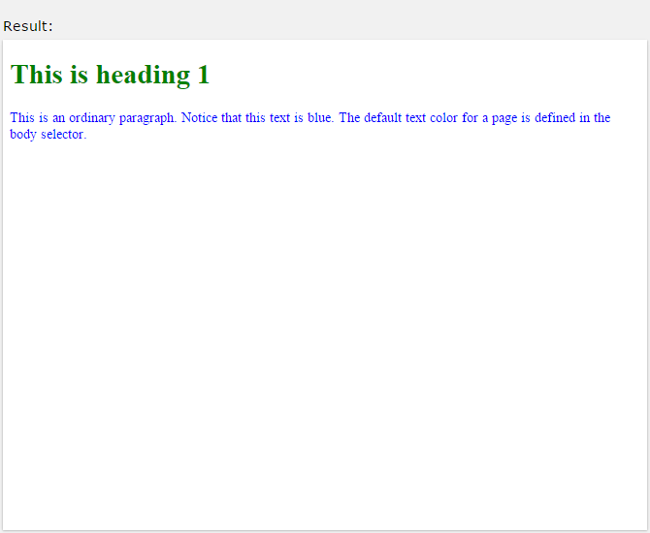
2.6.1 Text Color
Example
body {
color: blue;
}
h1 {
color: green;
}

Slide 59
2.6.2
Text Alignment
The text.
text-align
property is used to set the horizontal alignment of a
A text can be left or right aligned, centered, or justified.
The following example shows center aligned, and left and right aligned text (left alignment is default if text direction is left-to- right, and right alignment is default if text direction is right-to- left):

Slide 60
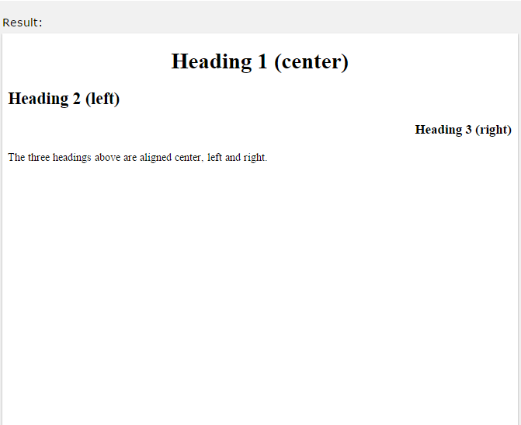
2.6.2 Text Alignment
Example
h1 {
text-align: center;
}
h2 {
text-align: left;
}
h3 {
text-align: right;
}

Slide 61
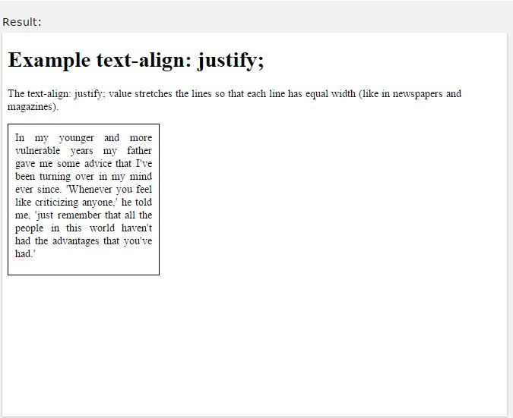
2.6.2 Text Alignment
When the text-align property is set to "justify", each line is stretched so that every line has equal width, and the left and right margins are straight (like in magazines and newspapers):
Example
div {
text-align: justify;
}

Slide 62

2.6.3
Text Decoration
The
text-decoration
property is used to set or remove decorations
from text. The value
text-decoration: none;
is often
used
to remove
underlines from links:
Example
a {
text-decoration: none;
}

Slide 63
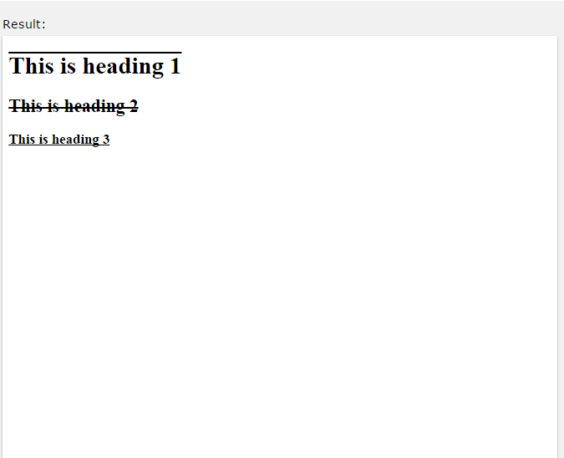
values are used to decorate text:
2.6.3 Text Decoration
The other
Example
text-decoration
h1 {
text-decoration: overline;
}
h2 {
text-decoration: line-through;
}
h3 {
text-decoration: underline;
}

Slide 64
2.6.4
Text Transformation
The text-transform property is used to specify uppercase and lowercase letters in a text.
It can be used to turn everything into uppercase or lowercase letters, or capitalize the first letter of each word:

Slide 65
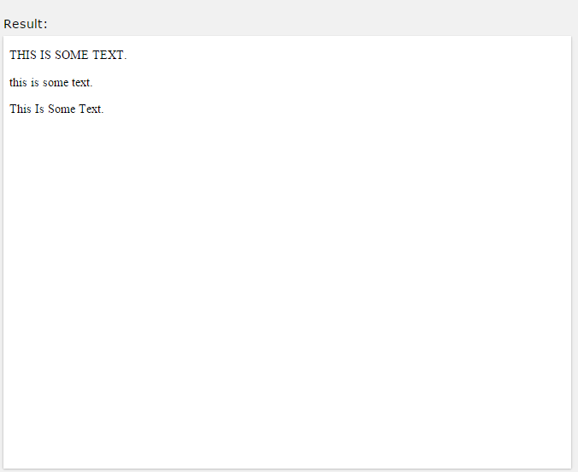
2.6.4 Text Transformation
Example
p.uppercase {
text-transform: uppercase;
}
p.lowercase {
text-transform: lowercase;
}
p.capitalize {
text-transform: capitalize;
}

Slide 66
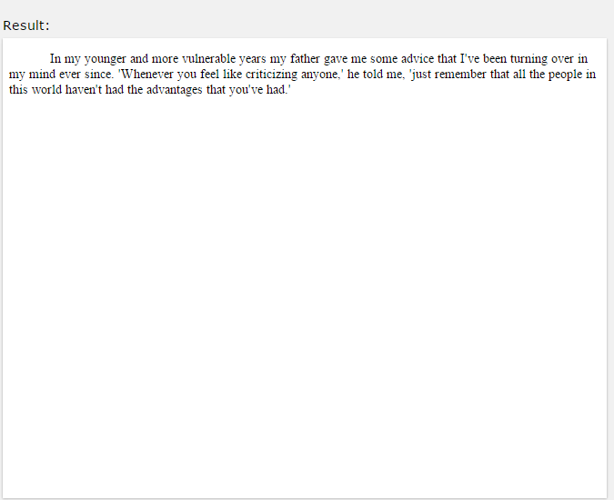
2.6.5
Text Indentation
The text-indent
property is used to specify the indentation of the
first line of a text:
Example
p {
text-indent: 50px;
}

Slide 67
2.6.6
Letter Spacing
The letter-spacing property is used to specify the space between the characters in a text.
The following example demonstrates how to increase or decrease the space between characters:

Slide 68
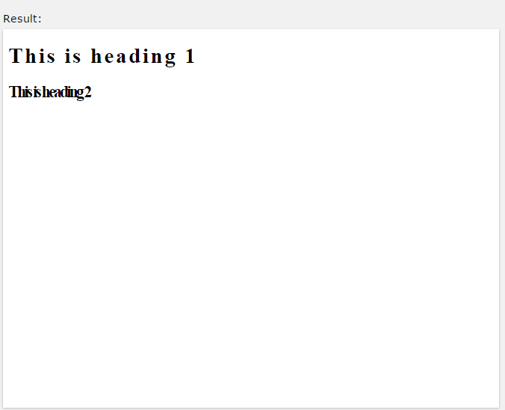
2.6.6 Letter Spacing
Example
h1 {
letter-spacing: 3px;
}
h2 {
letter-spacing: -3px;
}

Slide 69
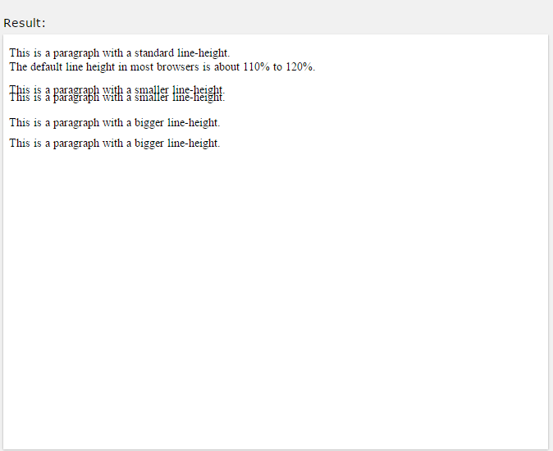
2.6.7
Line Height
The
line-height
property is used to specify the space between lines:
Example
p.small {
line-height: 0.8;
}
p.big {
line-height: 1.8;
}

Slide 70
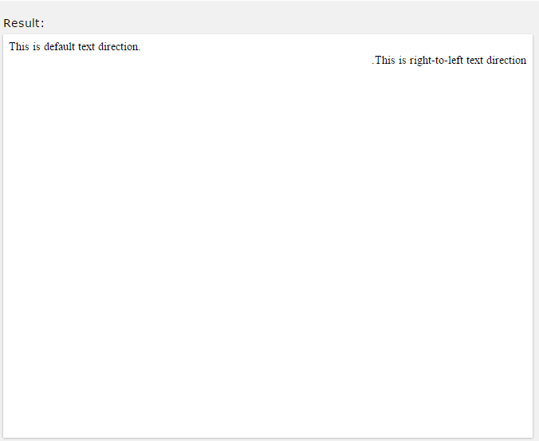
2.6.8
Text Direction
The direction
property is used to change the text direction of an
element:
Example
div {
direction: rtl;
}

Slide 71
2.6.9
Word Spacing
The word-spacing property is used to specify the space between the words in a text.
The following example demonstrates how to increase or decrease the space between words:

Slide 72
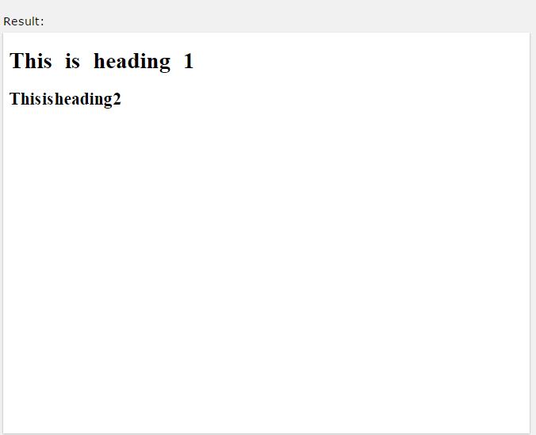
2.6.9 Word Spacing
Example
h1 {
word-spacing: 10px;
}
h2 {
word-spacing: -5px;
}

Slide 73
2.6.10 All CSS Text Properties
Property | Description
color | Sets the color of text
direction | Specifies the text direction/writing direction
letter-spacing | Increases or decreases the space between characters in a text
line-height | Sets the line height

Slide 74
2.6.10 All CSS Text Properties
text-align | Specifies the horizontal alignment of text
text-decoration | Specifies the decoration added to text
text-indent | Specifies the indentation of the first line in a text-block
text-shadow | Specifies the shadow effect added to text
text-transform | Controls the capitalization of text

Slide 75
2.6.10 All CSS Text Properties
unicode-bidi | Used together with the direction property to set or return whether the text should be overridden to support multiple languages in the same document
vertical-align | Sets the vertical alignment of an element
white-space | Specifies how white-space inside an element is handled
word-spacing | Increases or decreases the space between words in a text

Slide 76
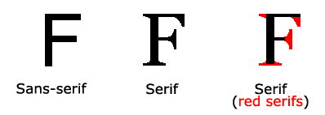
2.7 CSS Fonts
The CSS font properties define the font family, boldness, size, and the style of a text.
2.7.1 Difference Between Serif and Sans-serif Fonts

Slide 77
2.7.2 CSS Font Families
In CSS, there are two types of font family names:
generic family - a group of font families with a similar look (like "Serif" or "Monospace")
font family - a specific font family (like "Times New Roman" or "Arial")

Slide 78
2.7.2 CSS Font Families
•
Generic family | Font family | Description
Serif | Times New Roman Georgia | Serif fonts have small lines at the ends on some characters
Sans-serif | Arial Verdana | "Sans" means without - these fonts do not have the lines at the ends of

Slide 79
2.7.2 CSS Font Families
 |  | characters
Monospace | Courier New Lucida Console | All monospace characters have the same width
Note: On computer screens, sans-serif fonts are considered easier to read than serif fonts.

Slide 80
2.7.3 Font Family
The font family of a text is set with the The font-family property should hold
font-family
property.
several font names as a
"fallback" system. If the browser does not support the first font, it tries the next font, and so on.
Start with the font you want, and end with a generic family, to let the browser pick a similar font in the generic family, if no other fonts are available.
Note: If the name of a font family is more than one word, it must be in quotation marks, like: "Times New Roman".
More than one font family is specified in a comma-separated list:

Slide 81
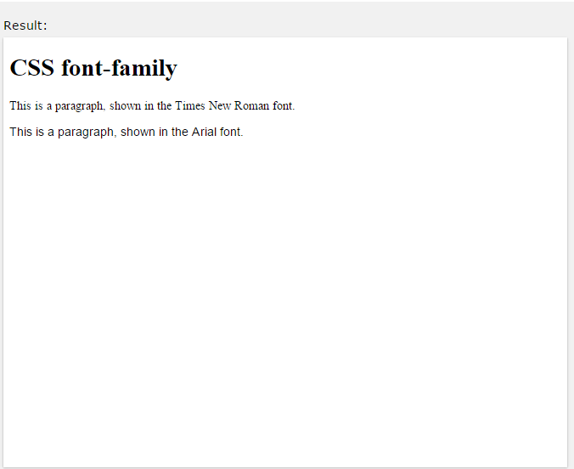
2.7.3 Font Family
Example
p {
font-family: "Times New Roman", Times, serif;
}

Slide 82
2.7.4
Font Style
The font-style property is mostly used to specify italic text. This property has three values:
normal - The text is shown normally
italic - The text is shown in italics
oblique - The text is "leaning" (oblique is very similar to italic, but less supported)

Slide 83
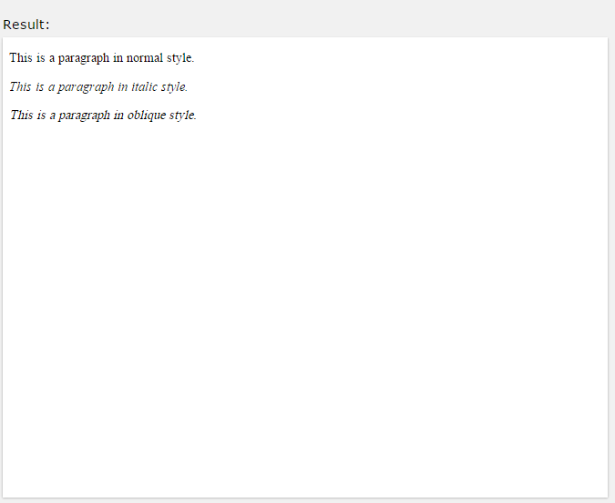
2.7.4 Font Style
Example
p.normal {
font-style: normal;
}
p.italic {
font-style: italic;
}
p.oblique {
font-style: oblique;
}

Slide 84
2.7.5
Font Size
The font-size property sets the size of the text.
Being able to manage the text size is important in web design. However, you should not use font size adjustments to make paragraphs look like headings, or headings look like paragraphs.
Always use the proper HTML tags, like <h1> - <h6> for headings and <p> for paragraphs.
The font-size value can be an absolute, or relative size. Absolute size:
Sets the text to a specified size
Does not allow a user to change the text size in all browsers (bad for accessibility reasons)

Slide 85
2.7.5 Font Size
Absolute size is useful when the physical size of the output is known
Relative size:
Sets the size relative to surrounding elements
Allows a user to change the text size in browsers
Note: If you do not specify a font size, the default size for normal text, like paragraphs, is 16px (16px=1em).

Slide 86
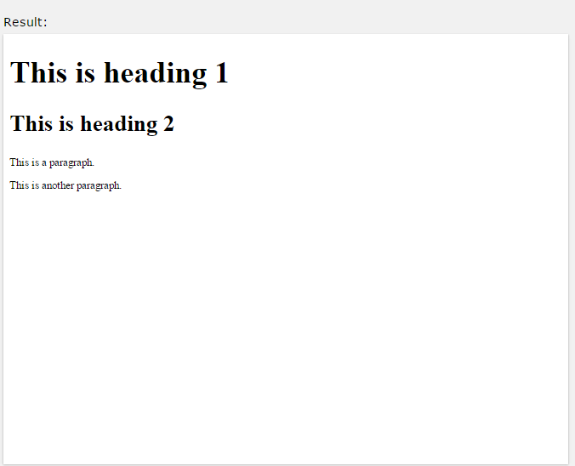
2.7.5.1 Set Font Size With Pixels
Setting the text size with pixels gives you full control over the text size:
Example
h1 {
font-size: 40px;
}
h2 {
font-size: 30px;
}
p {
font-size: 14px;
}

Slide 87
2.7.5.2 Set Font Size WithEm
To allow users to resize the text (in the browser menu), many developers use em instead of pixels.
The em size unit is recommended by the W3C.
1em is equal to the current font size. The default text size in browsers is 16px. So, the default size of 1em is 16px.
The size can be calculated from pixels to em using this formula: pixels/16=em

Slide 88
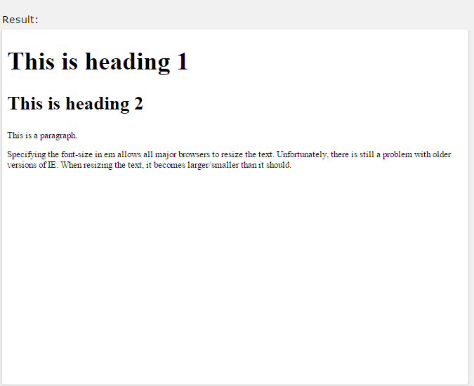
2.7.5.2 Set Font Size WithEm
Example
h1 {
font-size: 2.5em; /* 40px/16=2.5em */
}
h2 {
font-size: 1.875em; /* 30px/16=1.875em */
}
p {
font-size: 0.875em; /* 14px/16=0.875em */
}

Slide 89
2.7.5.2 Set Font Size WithEm
In the example above, the text size in em is the same as the previous example in pixels. However, with the em size, it is possible to adjust the text size in all browsers.
Unfortunately, there is still a problem with older versions of IE. The text becomes larger than it should when made larger, and smaller than it should when made smaller.

Slide 90
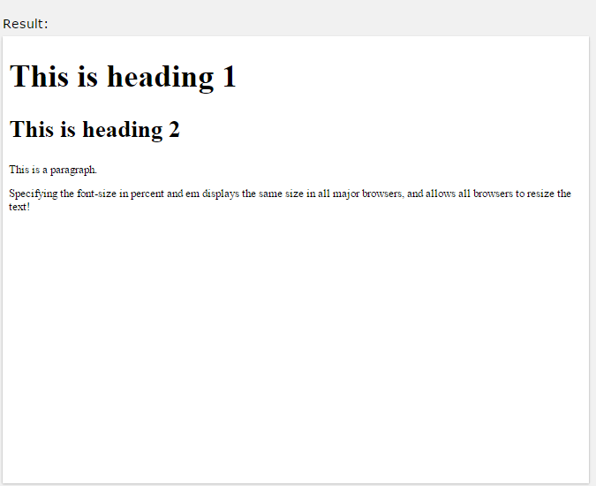
2.7.5.3 Use a Combination of Percent and Em
The solution that works in all browsers, is to set a default font-size in percent for the <body> element:
body {
font-size: 100%;
}
h1 {
font-size: 2.5em;
}
h2 {
font-size: 1.875em;
}
p {
font-size: 0.875em;
}

Slide 91
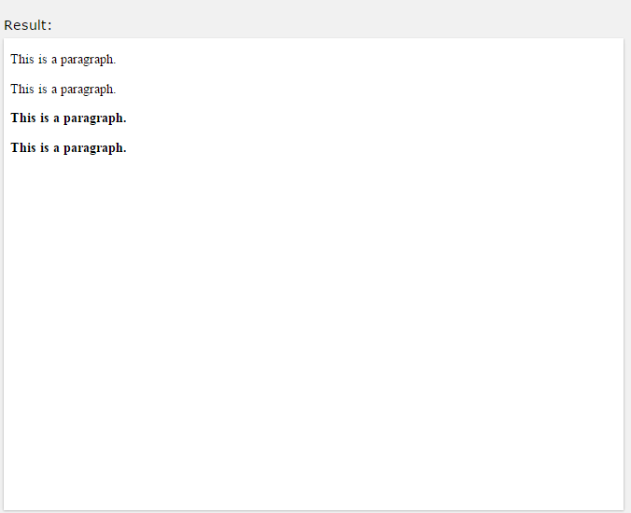
2.7.6
Font Weight
The
font-weight
property specifies the weight of a font:
Example
p.normal {
font-weight: normal;
}
p.thick {
font-weight: bold;
}

Slide 92
2.7.7
Font Variant
The font-variant
property specifies whether or not a text should be
displayed in a small-caps font.
In a small-caps font, all lowercase letters are
converted to
uppercase letters. However, the converted uppercase letters appears in a smaller font size than the original uppercase letters in the text.

Slide 93
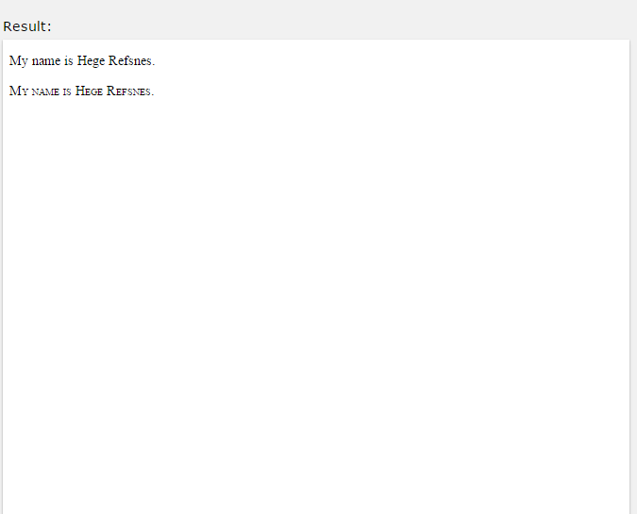
2.7.7 Font Variant
Example
p.normal {
font-variant: normal;
}
p.small {
font-variant: small-caps;
}

Slide 94
All CSS Font Properties
Property | Description
font | Sets all the font properties in one declaration
font-family | Specifies the font family for text
font-size | Specifies the font size of text
font-style | Specifies the font style for text
font-variant | Specifies whether or not a text should be displayed in a small-caps font
font-weight | Specifies the weight of a font

Slide 95

2.8 CSS Links
With CSS, links can be styled in different ways. Text Link Text Link Link Button Link Button
2.8.1 Styling Links
Links can be styled
with
any CSS property
(e.g.
,
color
font-
family,
background, etc.).
Example
a {
color: hotpink;
}

Slide 96
depending on
2.8.1 Styling Links
be styled
differently
In addition, links can what state they are in.
The four links states are:
a:link - a normal, unvisited link
a:visited - a link the user has visited
a:hover - a link when the user mouses over it
a:active - a link the moment it is clicked

Slide 97
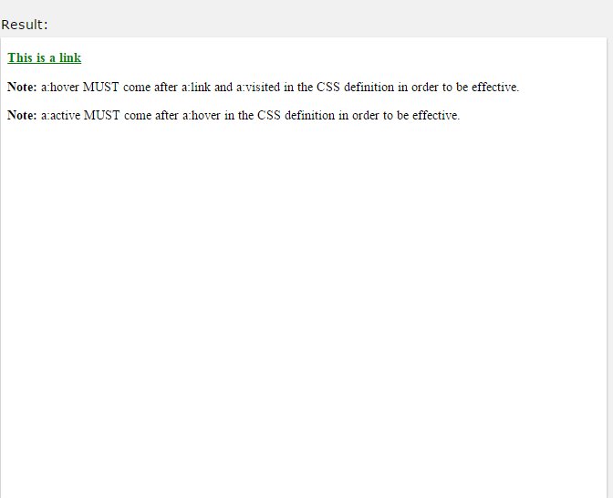
2.8.1 Styling Links
/* unvisited link */ a:link {
color: red;
}
/* visited link */ a:visited {
color: green;
}
/* mouse over link */ a:hover {
color: hotpink;
}
/* selected link */ a:active {
color: blue;
}
When setting the style for several link states, there are some order rules:
a:hover MUST come after a:link and a:visited
a:active MUST come after a:hover

Slide 98
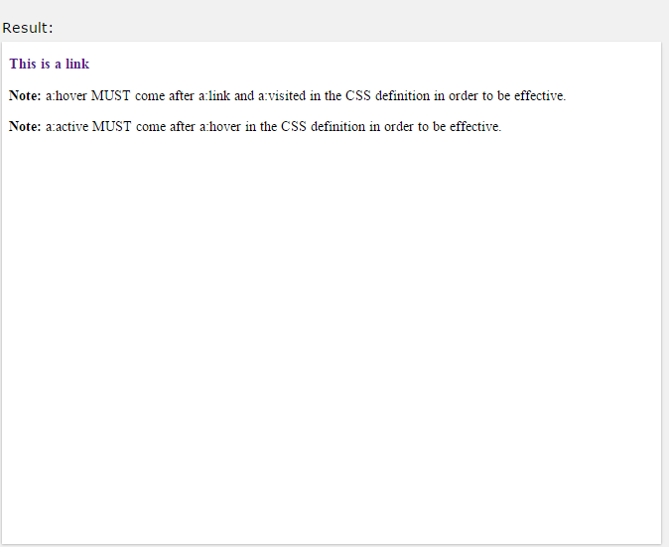
2.8.2
Text Decoration
The
text-decoration
property is mostly used to remove underlines
from links:
a:link {
text-decoration: none;
}
a:visited {
text-decoration: none;
} a:hover {
text-decoration: underline;
}
a:active {
text-decoration: underline;
}

Slide 99
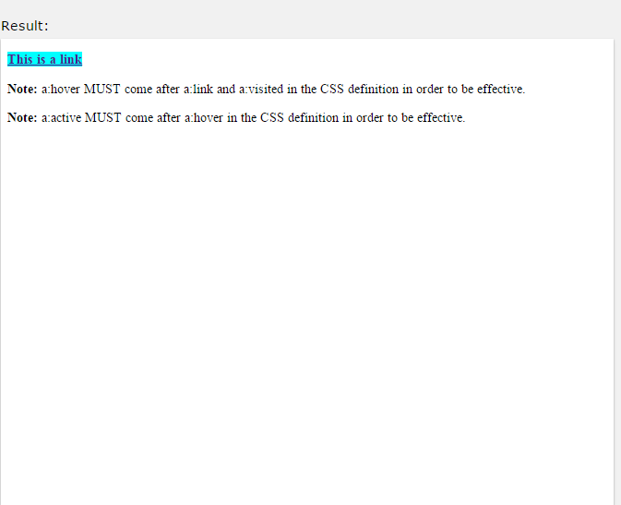
2.8.3
Background Color
The background-color property background color for links:
can be used
to specify a
a:link {
background-color: yellow;
}
a:visited {
background-color: cyan;
}
a:hover {
background-color: lightgreen;
}
a:active {
background-color: hotpink;
}

Slide 100
2.9 CSS Lists
1.Coffee 2.Tea
3.Coca Cola
Coffee
Tea
Coca Cola
2.9.1 HTML Lists and CSS List Properties
In HTML, there are two main types of lists:
unordered lists (<ul>) - the list items are marked with bullets
ordered lists (<ol>) - the list items are marked with numbers or letters

Slide 101
2.9.1 HTML Lists and CSS List Properties
The CSS list properties allow you to:
Set different list item markers for ordered lists
Set different list item markers for unordered lists
Set an image as the list item marker
Add background colors to lists and list items

Slide 102
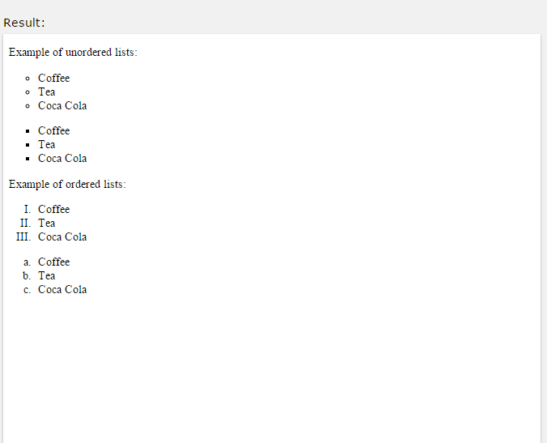
2.9.2
Different List Item Markers
The list-style-type property specifies the type of list item marker.
The following example shows some of the available list item markers:
ul.a {
list-style-type: circle;
}
ul.b {
list-style-type: square;
}
ol.c {
list-style-type: upper-roman;
}
ol.d {
list-style-type: lower-alpha;
}

Slide 103

2.9.3
An Image as The List Item Marker
The
list-style-image
property specifies an image as the list item
marker:
Example
ul {
list-style-image: url('sqpurple.gif');
}

Slide 104
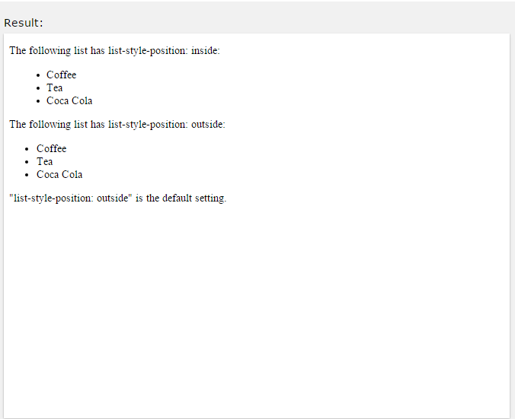
2.9.4
Position The List Item Markers
The list-style-position property specifies whether the markers should appear inside or outside the content flow:
Example
list-item
ul {
list-style-position: inside;
}

Slide 105

2.9.5
List - Shorthand property
The list-style
property is a shorthand property. It is used to set all
the list properties in one declaration:
Example
ul {
list-style: square inside url("sqpurple.gif");
}

Slide 106
When using the shorthand property, the order of the property values are:
2.9.5 List - Shorthand property
list-style-type (if a list-style-image is specified, the value of
•
this property will be displayed if the image for some reason cannot be displayed)
list-style-position (specifies whether the list-item markers should appear inside or outside the content flow)
list-style-image (specifies an image as the list item marker)
•
If one of the property values above are missing, the default value for the missing property will be inserted, if any.

Slide 107
2.9.6 Styling List With Colors
We can also style lists with colors, to make them look a little more interesting.
Anything added to the <ol> or <ul> tag, affects the entire list, while properties added to the <li> tag will affect the individual list items:

Slide 108
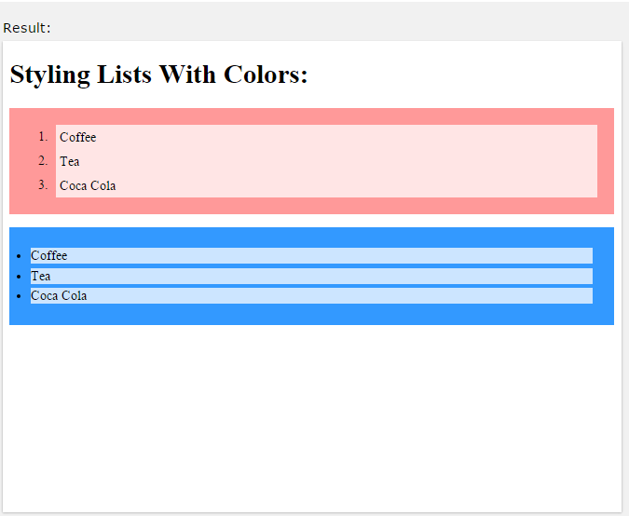
Example
2.9.6 Styling List With Colors
ol {
background: #ff9999; padding: 20px;
}
ul {
background: #3399ff; padding: 20px;
}
ol li {
background: #ffe5e5; padding: 5px;
margin-left: 35px;
}
ul li {
background: #cce5ff; margin: 5px;
}

Slide 109
All CSS List Properties
2.9.7
Property | Description
list-style | Sets all the properties for a list in one declaration
list-style- image | Specifies an image as the list-item marker
list-style- position | Specifies if the list-item markers should appear inside or outside the content flow
list-style-type | Specifies the type of list-item marker

Slide 110
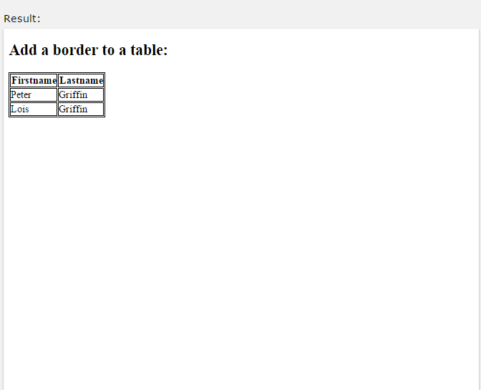
2.10.1 Table Borders
To specify table borders in CSS, use the border property.
The example below specifies a black border for <table>, <th>, and
<td> elements:
Example
table, th, td {
border: 1px solid black;
}

Slide 111
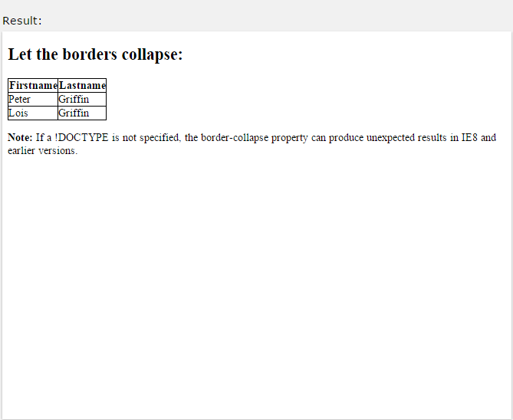
2.10.2 Collapse Table Borders
The border-collapse
property sets whether the table borders should
be collapsed into a single border:
Example
table {
border-collapse: collapse;
}
table, th, td {
border: 1px solid black;
}

Slide 112
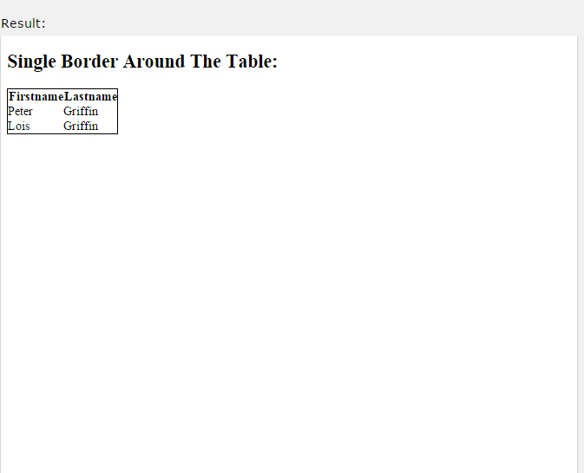
specify
2.10.2 Collapse Table Borders
around
the table,
only
If you only want a border the border property for <table>:
Example
table {
border: 1px solid black;
}

Slide 113
2.10.3 Table Width and Height
Width
and height of a and height properties.
table
are defined by
the width
The example below sets the width of the table to 100%, and the height of the <th> elements to 50px:

Slide 114
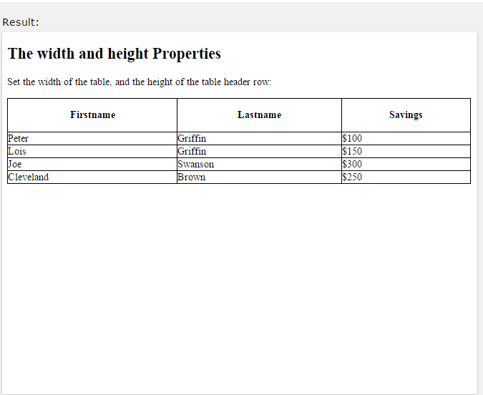
2.10.3 Table Width and Height
Example
table {
width: 100%;
}
th {
height: 50px;
}

Slide 115

2.10.4 Horizontal Alignment
The text-align property sets the horizontal alignment (like left, right, or center) of the content in <th> or <td>.
By default, the content of <th> elements are center-aligned and the content of <td> elements are left-aligned.
The following example left-aligns the text in <th> elements:
Example
th {
text-align: left;
}

Slide 116

2.10.5 Vertical Alignment
The vertical-align property sets the vertical alignment (like top, bottom, or middle) of the content in <th> or <td>.
By default, the vertical alignment of the content in a table is middle (for both <th> and <td> elements).
The following example sets the vertical text alignment to bottom for <td> elements:
Example
td {
height: 50px;
vertical-align: bottom;
}

Slide 117

2.10.6 Table Padding
To control the space between the border and the content in a table, use the padding property on <td> and <th> elements:
Example
th, td {
padding: 15px; text-align: left;
}

Slide 118
2.10.7 Horizontal Dividers
First Name | Last Name | Savings
Peter | Griffin | $100
Lois | Griffin | $150
Joe | Swanson | $300
Add the dividers:
border-bottom
property to <th> and <td> for horizontal

Slide 119

2.10.7 Horizontal Dividers
Example
th, td {
border-bottom: 1px solid #ddd;
}

Slide 120
2.10.8 Hoverable Table
Use the :hover over:
selector on <tr> to highlight table rows on mouse
First Name | Last Name | Savings
Peter | Griffin | $100
Lois | Griffin | $150
Joe | Swanson | $300

Slide 121
2.10.9 Striped Tables
First Name | Last Name | Savings
Peter | Griffin | $100
Lois | Griffin | $150
Joe | Swanson | $300
For zebra-striped
tables, use the nth-child() selector to all even (or odd) table rows:
and add
a background-color

Slide 122
2.10.9 Striped Tables
Example
tr:nth-child(even) {background-color: #f2f2f2}

Slide 123
2.10.10 Table Color
The example below specifies the background color and text color of <th> elements:
First Name | Last Name | Savings
Peter | Griffin | $100
Lois | Griffin | $150

Slide 124

2.10.10 Table Color
Joe | Swanson | $300
Example
th {
background-color: #4CAF50; color: white;
}

Slide 125
2.10.11 Responsive Table
A responsive table will display a horizontal scroll bar if the screen is too small to display the full content:
First Nam e | Last Nam e | Po in ts | Po in ts | Po in ts | Po in ts | Po in ts | Po in ts | Po in ts | Po in ts | Po in ts | Po in ts | Po in ts | Po int s
Jill | Smith | 50 | 50 | 50 | 50 | 50 | 50 | 50 | 50 | 50 | 50 | 50 | 50
Eve | Jacks on | 94 | 94 | 94 | 94 | 94 | 94 | 94 | 94 | 94 | 94 | 94 | 94
Ada | Johns | 67 | 67 | 67 | 67 | 67 | 67 | 67 | 67 | 67 | 67 | 67 | 67

Slide 126

around
2.10.11 Responsive Table
m | on
Add a container element (like <div>) with the <table> element to make it responsive:
Example
overflow-x:auto
<div style="overflow-x:auto;">
<table>
... table content ...
</table>
</div>

Slide 127
CSS Table Properties
2.10.12
Property | Description
border | Sets all the border properties in one declaration
border- collapse | Specifies whether or not table borders should be collapsed
border- spacing | Specifies the distance between the borders of adjacent cells
caption-side | Specifies the placement of a table

Slide 128
2.10.12 CSS Table Properties
 | caption
empty-cells | Specifies whether or not to display borders and background on empty cells in a table
table-layout | Sets the layout algorithm to be used for a table

